Slide 1


Form Filling Using Voice
Imagine filling out forms effortlessly, simply by speaking your answers. That's the power of voice-based form filling!
by Ashish Pal

Slide 2
Introduction to the Project
The Challenge
Our Solution
Forms can be time-consuming and tedious. We aim to streamline this process.
Develop a system that enables voice input for form data.

Slide 3

Importance of Voice-Based Interfaces
Accessibility
Efficiency
For individuals with disabilities.
Faster than manual entry.
User Experience
Hands-free, intuitive, and convenient.

Slide 4
Technologies Used: Flask and Speech Recognition
Flask
Speech Recognition
A Python web framework for building the backend.
For transcribing voice input to text.

Slide 5
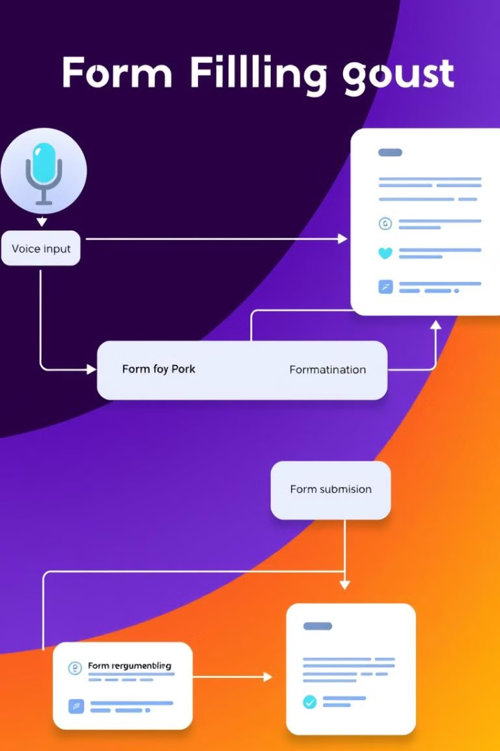
System Architecture and Workflow
1
User Input
Speak the form data.
2
Speech Recognition
Convert voice to text.
3
Form Processing
Extract data and fill the form.

Slide 6
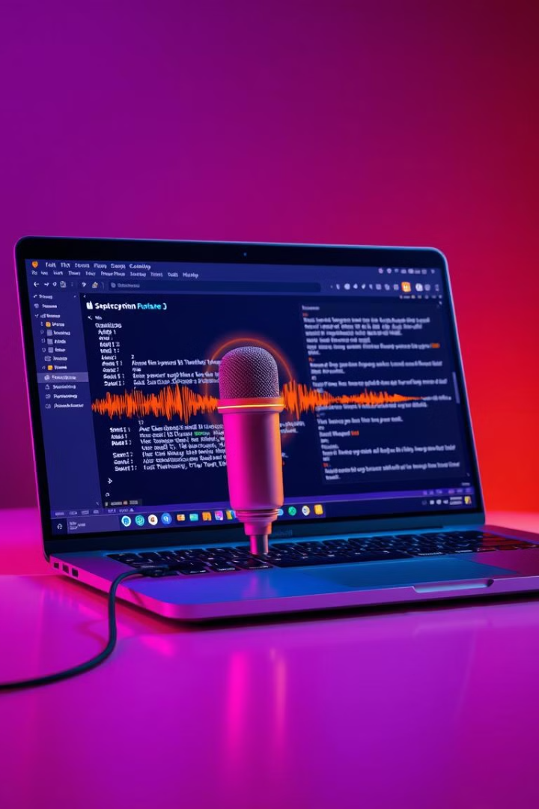



Implementing Speech Recognition in the Project
Library Integration
Importing and setting up the SpeechRecognition library.
Voice Input
Capturing audio from the user's microphone.
Transcription
Converting audio to text using the chosen recognition engine.

Slide 7

Filling the Form with Voice Input
Data Extraction
Form Mapping
Submission
Identifying key information from the transcribed text.
Matching extracted data to the correct form fields.
Submitting the filled form to the target server.

Slide 8



Challenges and Lessons Learned
Accuracy
1
Handling speech recognition errors.
Data Validation
2
Ensuring input is in the correct format.
Security
3
Protecting user data during voice input.

Slide 9
Conclusion and Future Enhancements
User Experience
1
Focus on improving usability.
Adaptive Learning
2
Personalizing voice recognition models.
Multi-Language Support
3
Expanding the project's reach.

